Slide 1

Music genre classification and prediction system
FINAL REVIEW
BY WRIDDHIRUP DUTTA (16BIS0145)
CSE4022 NATURAL LANGUAGE PROCESSING
G2 SLOT Prof. Sharmila Banu K.

Slide 2
abstract
This project is primarily aimed to create an automated system to classify and predict music genres. The first step included finding good features that demarcated genre boundaries clearly. A total of five features, namely MFCC vector, Chroma frequencies, spectral roll -off , spectral centroid, spectral bandwidth, zero-crossing rate were used for obtaining feature vectors for the classifiers from the GTZAN genre dataset. The dataset consist of 1000 samples of 10 genres. For detecting the genre of the test audio, an artificial neural network model has been created. The model is further compared with another model made using Support vector machine (SVM). The features from the spectrogram sample is fed as the input and it will show the genre of the song as output. The project is made using python.

Slide 3
GTZAN DATASET
Each audio clips has a length 30 seconds, are 22050Hz Mono 16-bit files. The dataset having 1000 samples incorporates samples from variety of sources like CDs, radios, microphone recordings etc. We split the dataset in 0.7 : 0.3 ratio and used k-fold cross validation for reporting the results.
The genres I am classifying are:
Blues
Classical
Country
Disco
Hip-hop
Jazz
Metal
Pop
Reggae
Rock

Slide 4
Basic packages needed for the system in python
Librosa
Sklearn
Tensorflow
Keras
Scipy
Numpy
Pandas
Matplotlib

Slide 5
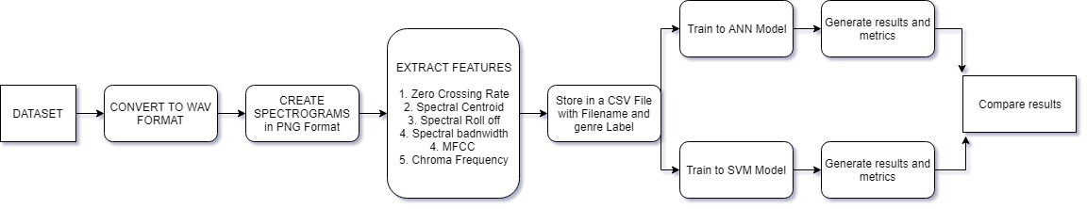
Flow diagram

Slide 6
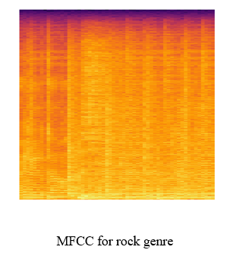
Features extracted:
Zero Crossing Rate
Spectral Centroid
Spectral Roll off
Mel-Frequency Cepstral Coefficients (MFCC)
Chroma Frequencies

Slide 7
Basic steps:
Getting the dataset
Pre-processing the dataset
Cleaning unrequired values
Extracting features
Generating model
Training model and validating model (ANN and SVM)
Compare model accuracies

Slide 8
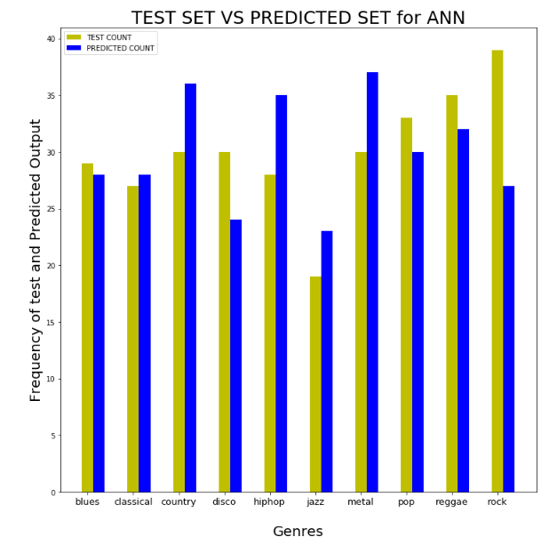
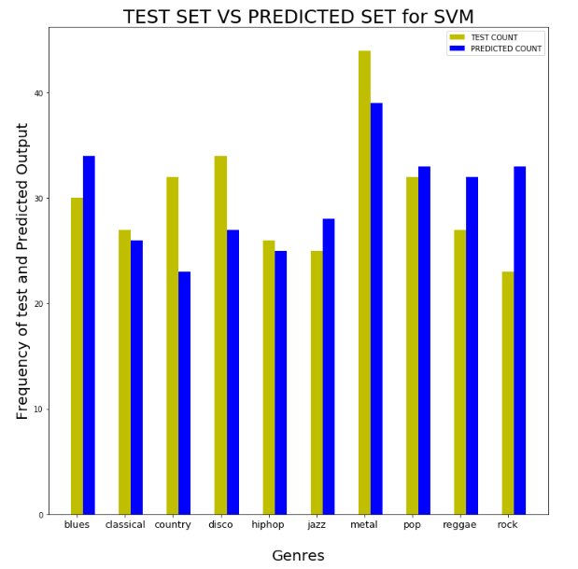
Output prediction comparison

Slide 9
Comparison of models
The accuracy is more in case of ANN Classifier than SVM classifier (68 % vs 67 %).
The ROC AUC Score is more for ANN model than SVM Model.
Overall the classifiers work same and the accuracies are almost same
The ANN Classifier takes more time to train the model, but it produces better output.
The loss decreases more some cases as the data is shuffled.
The accuracy and efficiency of both the models can be increased with more dataset
The loss in case of both the cases can be increased by using regularization parameters separately.

Slide 10
Future work...
The validation set accuracy can be increased with more amount of dataset
CNN model can be used in this case, but the accuracy will be low as all the images have same kind of features, hence the model wont be able to differentiate much.
The dataset can also be increased by 50% overlap for every 5s of the song, hence the data will increase by a factor of 1000.
Recommendation system can be made by content based or collaborative filtering model in such a way that the system will listen to a song and predict the genre and recommend top 5 songs like the given song.

Slide 11
CONCLUSION:
The music genre classification and prediction system has been successfully completed and the results are compared for better analysis. The prediction is almost accurate for ANN model whereas the SVM model needs more training set.

Slide 12
REFERENCES:
https://medium.com/@matanlachmish/music-genre-classification-470aaac9833d
https://github.com/mlachmish/MusicGenreClassification
Omar Diab, Anthony Manero, and Reid Watson. Musical Genre Tag Classification With Curated and Crowdsourced Datasets. Stanford University, Computer Science,1 edition, 2012.
https://thesai.org/Downloads/Volume8No8/Paper_44-Automatic_Music_Genres_Classification.pdf
https://ieeexplore.ieee.org/document/7806258/
Music Genre Classification by Archit Rathore, Margaux Dorido
stackoverflow.com
towardsdatascience.com
https://librosa.github.io/librosa/
https://librosa.github.io/librosa/feature.html
https://www.youtube.com/watch?v=KzevshgDv8g
https://www.youtube.com/watch?v=dxSfkRLQbUs

Slide 13
Thank you ☺

